Slide 1
Linearizing Transformer with Key-Value Memory
By Libang Xia,Yaqi Hu,Luoyuan Zhang,Zhaojin Yin,Gonglin Chen

Slide 2
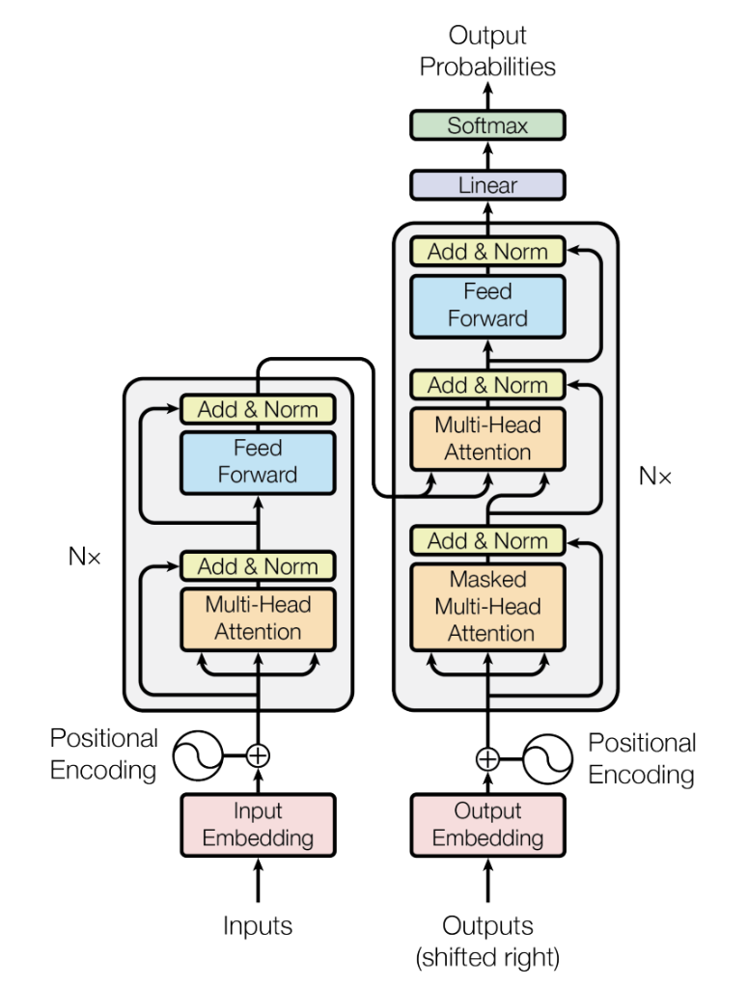
Background
Challenges with Vanilla Transformers:
Computationally expensive due to quadratic scaling.
Limits efficient deployment of large-scale models like GPT-3, Image Transformer.
High energy consumption and greenhouse gas emission concerns.

Slide 3
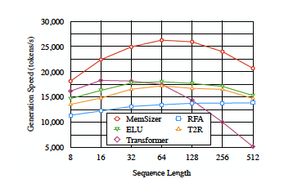
Introduction MemSizer
Efficient transformer variant.
Incorporates benefits of low-rank projections.
Utilizes memory-efficient recurrent-style generation similar to kernel-based transformers.
Key-value memory layer introduced, replacing the multi-head attention layer in the vanilla transformer.
Simplifies the design of keys and places more emphasis on modeling values.
Offers linear time complexity and constant memory complexity.

Slide 4
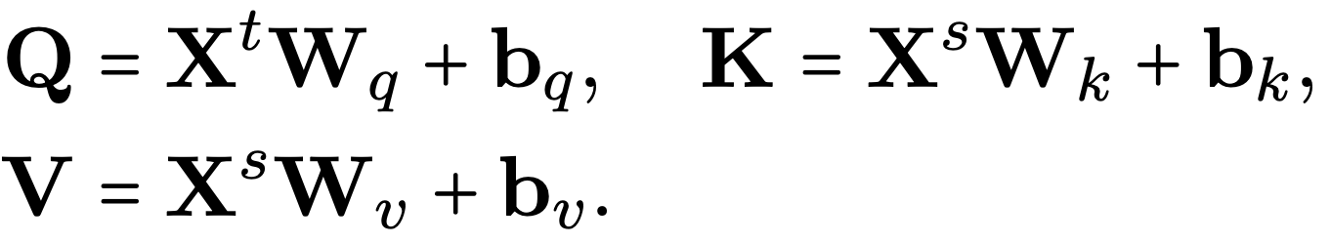
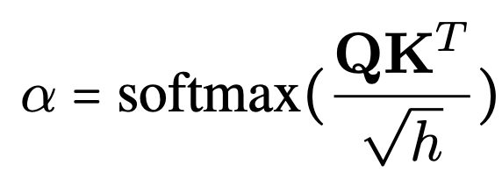

Preliminaries
Naive Transformer
Attention Score:
This attention score needs to be calculated for each head of attention!
As the length of source vector increases, the complexity increases by its squared.
Dominant Complexity O(M*N*d)
Notes:
X^s is the source vector where X^t is the target vector,
where the memory key K and value V are point-wise projections of the source Xs
The complexity of transformer is dominated by its sequence length, saying M*N*D where M, N is the input size, and D model dimensions.

Slide 5
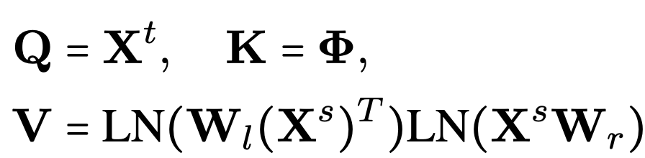
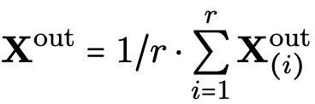
Methodology: MemSizer
NEW Attention
Input dependent K and V.
Dynamic length projections with linear kernel (X^{T}X)
Multi-head Computation (faster):
Notes:
The Key(K) matrix is a learnable parametric matrix, The Value(V) matrix contains k memory value vectors of d dimension. Fixed-size space R(k*d). This unbalanced mechanism emphasizes learning better input dependent values to match with input dependent keys.
Use linear kernel to cancel out the length dimension. Use 2 W matrices to project source information into k global memory value vectors, LN is layer normalization, which makes the training robust. To control magnitude of V, multiply the V by scaling factor of 1/M.

Slide 6
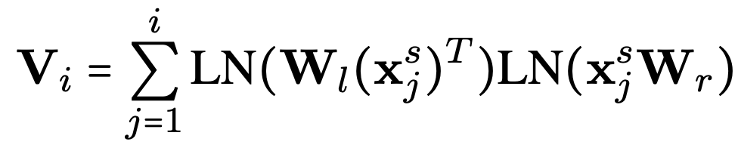
Recurrent Computation(memory efficient):
For each generation step i:
Since x^{s}_{j}is just the jth row of X^{s}, V_{i} can be seen as a rolling-sum matrix
Use cached matrix for computation. (avoid quadratic computation with sequence length)
Notes:
For each time we calculate V, we add a new value into the summation, which can be transformed into a rolling sum of Vi comparing to Vi-1

Slide 7
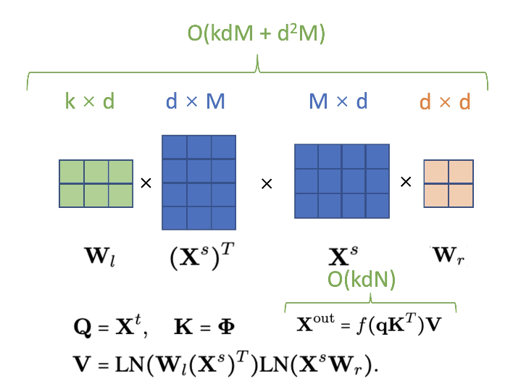
MemSizer Memory Network
With k much smaller than M,N(the input size of naive transformer), the complexity of MemSizer shows a great improvement.
Comparison with naive transformer:
O(M*N*d + Nd2+Md2)
Notes:
Complexity of Naive Transformer:
The time complexity of the computation of Q, K, and V for all r heads is O(Nd2), O(Md2), and O(Md2),
The time complexity of the computation of attention matrices for all r heads is O(M N d)
Adds up and compare to the summation of MemSizer, comparison shows a transformation from (MNd to Ndk + Mdk)

Slide 8
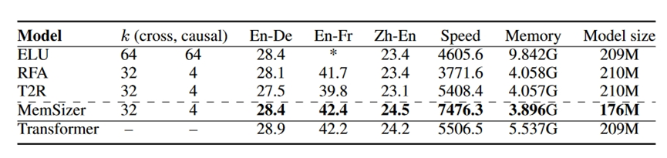
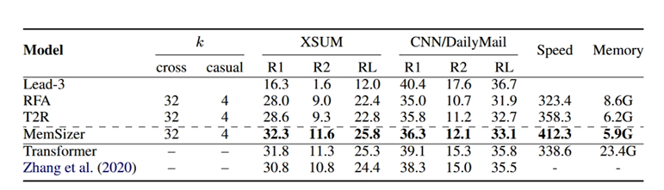
Experiments and Analysis
In this paper, we present experiments on three typical sequence generation tasks in NLP, including machine translation, abstractive text summarization, and language modeling.
Task 1: Machine translation
Task 2: Abstractive Text Summarization
MemSizer achieves faster generation time and more efficient GPU memory utilization.
MemSizer achieves the largest speed-up (22% speed-up compared to the vanilla transformer) and the smallest memory consumption (75% reduction compared to the vanilla transformer)

Slide 9
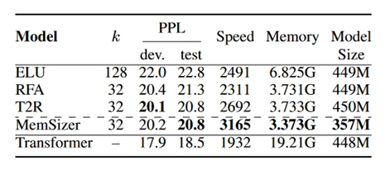
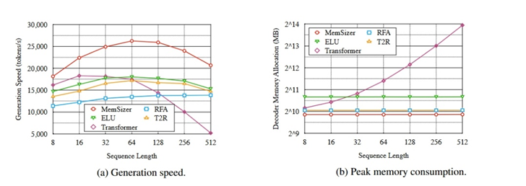
Task 3: Language Modeling
MemSizer is more advantageous with cross-attention in encoder-decoder architectures.
Analysis
Dramatically outpacing the vanilla transformer model in longer sequence generation (300% speedup)
Outperforms other linear recurrent variants by large margins (35% faster than ELU for 512 length)
May better when the batch size larger.

Slide 10
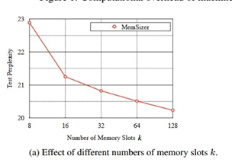
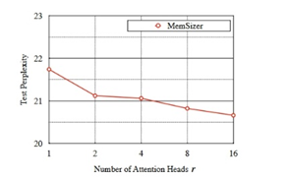
Performance gets better as k goes larger.
Number of attention heads slightly affects the test perplexity, with slightly better performance.

Slide 11
Future Work and Summary
Improve
Performance gap observed compared to vanilla transformer in tasks like language modeling and CNN/Daily summarization.
Potential to make the attention sparser to reduce training and generation computation.
Feedforward layer remains computationally intensive.
Broader Impact:
Contributes to the NLP and AI research communities.
Boosts natural language generation models useful for text editing, conversational agents, and question-answering systems.
Speeds up generative tasks such as machine translation, text summarization, and virtual assistants.

Slide 12
Our Thoughts
1. The Memsizer is influenced by the batch size, we may vary the batch size to see how it performed.
2. The model is only tested in few datasets, we could test it on other datasets, and see what it performed. Especially some short or very long length datasets

Slide 13
THANK YOU!!!
Q&A

